Slide 1
CODE PRESENTATION OUT PUT
ARINITWE KEVIN
2023-B071-30761

Slide 2
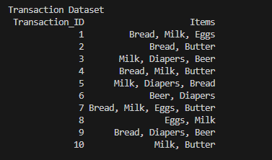
PART A

Slide 3
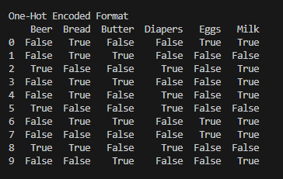
TRANSACTION DATA IN ENCODED FORMAT

Slide 4
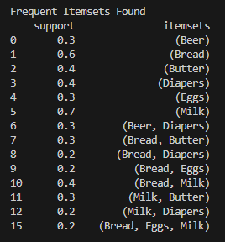
PART B

Slide 5
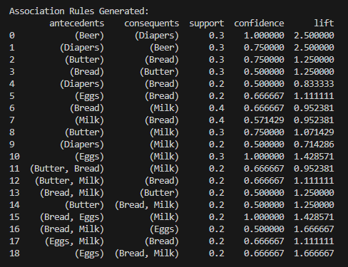
ASSOCIATION RULES GENERATED

Slide 6
PART C
Strongest three rules based on lift
1. Beer - Diapers
Support = 0.3
Confidence =1
Lift = 2.5
Explanation: This means that beer buyers may also buy diapers.
2. (Bread, Milk) → Eggs
Support = 0.2
Confidence =0.6667
Lift = 1.6667
Explanation: This means that customers who purchase milk and bread are likely to buy eggs too

Slide 7
3. Eggs → Milk
Support = 0.2
Confidence =0.6667
Lift = 1.6667
Explanation: This means that customers who purchase eggs are likely to buy milk

Slide 8
RECOMMENDATION
Product Placement
Place Beer and Diapers closer together in the store.
This can increase cross-selling and impulse buying.
Promotions and Bundles
Offer discounts or bundles for Eggs and Milk.
Helps increase total sales per customer.

